Slide 1


Low Noise Amplifier Design for
Wireless Body Area Network Applications
A VLSI Domain Project
Group no. 27
Saurabh Suman (1PE17EC122)
Matli Venkata Sai Mohit Mayur (1PE17EC074)
Sachin P B (1PE17EC110)
Guided by:
Prof. Muralidhar S

Slide 2
ABSTRACT
Wireless Body Area Network (WBAN) is a wireless network of wearable computing devices that may be implanted or mounted on the human body. Low Noise Amplifier (LNA) is the first functional block in a WBAN receiver. In order to maintain the required SNR, high gain LNA is desirable which further reduces the overall Noise Figure (NF) of the receiver block. In this project work we are exploring and targeting to design LNA to meet balance amongst these parameters, in particular Low Power and if possible High Gain

Slide 3
PROBLEM STATEMENT
After conducting the Literature survey, we have observed that most Low Noise Amplifiers suffer from higher Noise Figure, high power consumption and reduced stability and gain. To overcome these potential problems, an attempt has been made to improve the above mentioned parameters.

Slide 4
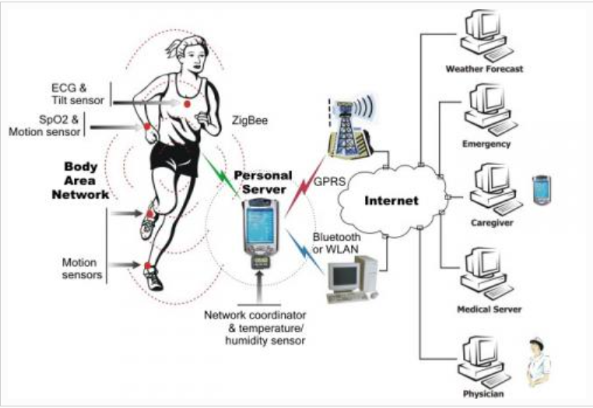
WIRELESS BODY AREA NETWORK (WBAN)
WBAN is a wireless network which is comprised of wearable devices that have the ability to measure and gather data regarding the physiological condition of the user.
A WBAN connects independent nodes (e.g. sensors and actuators) that are situated in the clothes, on the body or under the skin of a person.

Slide 5
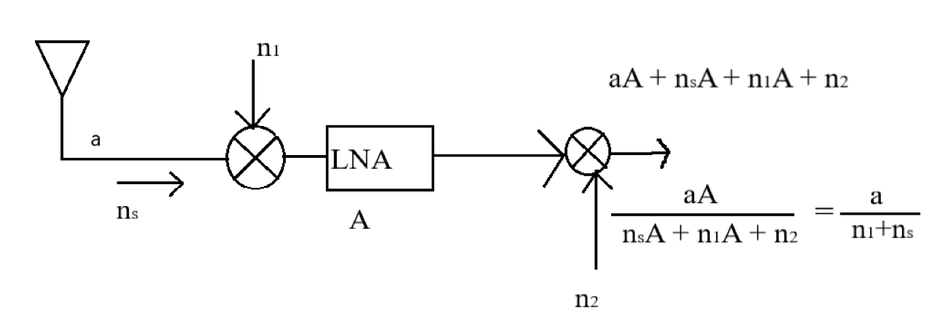
How Exactly does a LNA work?
.

Slide 6
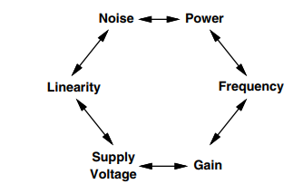
Analog design trade off diagram
Designing of a RFICs is a
challenging and dynamic
process where the designer
has to optimize lot of trade-offs
such as Noise, gain, stability,
power and Linearity

Slide 7
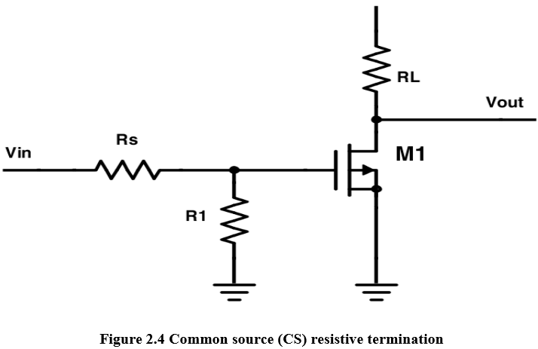
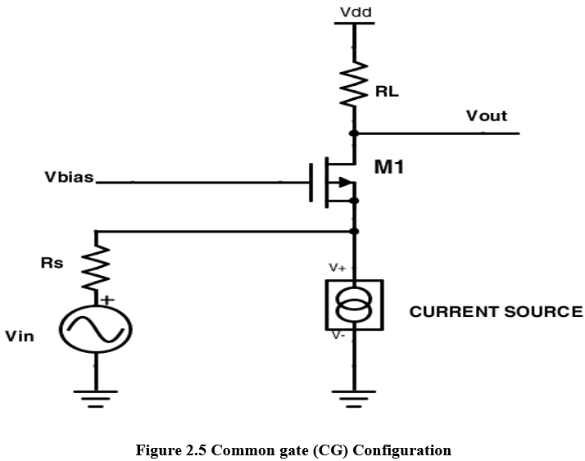
BASIC CIRCUIT OF EACH TOPOLOGY
vdd
Common source resistive termination
Common gate configuration

Slide 8
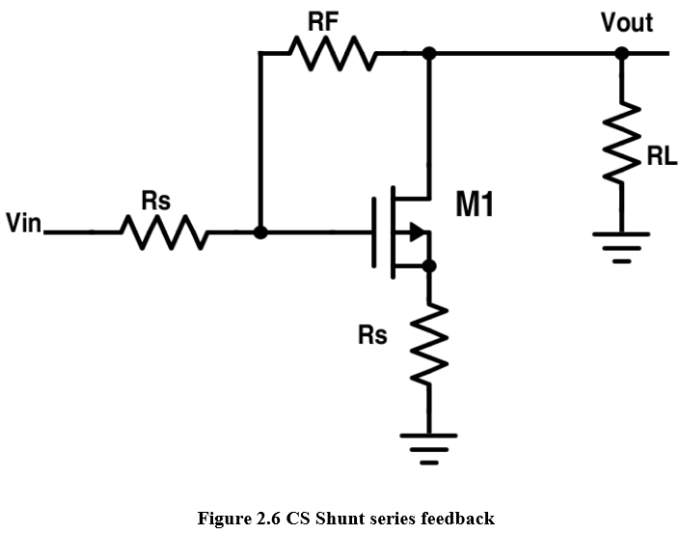
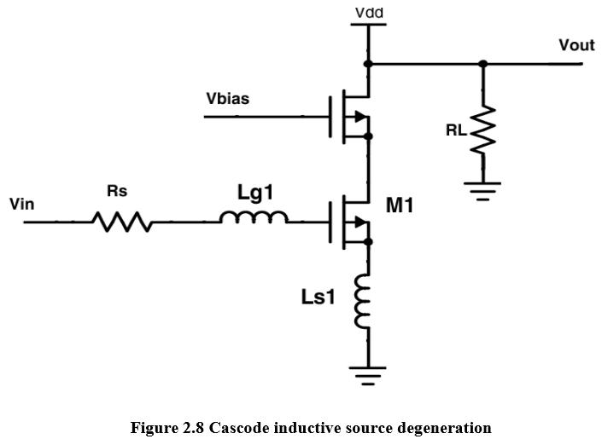
BASIC CIRCUIT OF EACH TOPOLOGY
CS Shunt series feedback
Cascode ISD Configuration

Slide 9
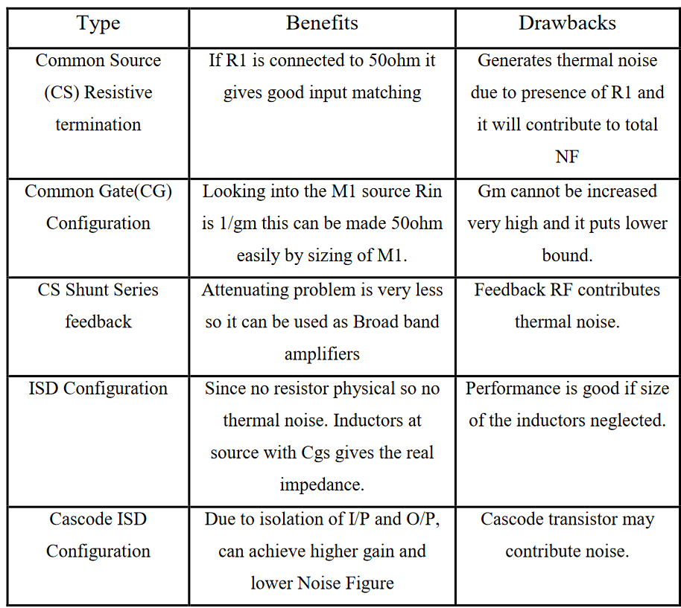
DIFFERENT TYPES OF TOPOLOGIES

Slide 10
LITERATURE SURVEY
.
[5] 2019 The Paper designed a wireless body area network circuit using LNA that can work at low supply voltage using 130nm CMOS technology. This paper mainly aims at good gain and good linearity. | [12] 2016 The paper proposes a Folded Cascode (FC) Low Noise Amplifier (LNA) for low voltage and high gain RF applications. This paper mainly focuses on low voltage high gain RF applications. | [13] 2018 The paper aims to achieve a low noise figure, reasonable power gain and low power consumption in 3.1-10.6 GHz. Improved π-network and T-network are used to obtain a high and smooth power gain.
Process - 0.13 um Rev voltage gain - (-33.45 db) Noise fig. - 1.7 db Operating freq - 2.4GHz Good linearity Power dissipated - 1.44mW
Process - 0.18 um Noise Fig. - 2.9 db Operating freq - 2.44 GHz Power dissipated - 3.8mW FOM - 13.11db
Process - 0.18 um Noise Fig. - 3.6 db Operating freq. -10 GHz Power dissipated - 11.3mW FOM - 6.3 db

Slide 11
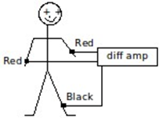
HOW SIGNAL IS OBTAINED?
[3] The heart puts out a signal varying from about −1 mV to +1 mV at a frequency of about 0.1-150 Hz.
An electrode is kept on the skin of each arm and one leg is used as ground which is used as reference.
Whole body acts as an antenna.
The noise induced by EM waves passing through the body is common to both arm-leg inputs and thus is removed by the common mode rejection feature, with the leg input as the reference.
The output is the amplified cardiac signal alone

Slide 12
CHARACTERISTICS OF ECG/EEG SIGNAL:
These signals are very weak in amplitude and are low frequency signals
Their amplitude is generally below 5mV, and their frequency ranges from 0.1 to 150Hz.
Due to such small amplitude and frequency, it is very difficult to pick up these signals without losing important information.
Hence, proper amplification with good noise suppression becomes a major requirement in ECG amplifiers
LNA should have a high value of gain, small value of noise figure, considerable input and output impedance matching.

Slide 13
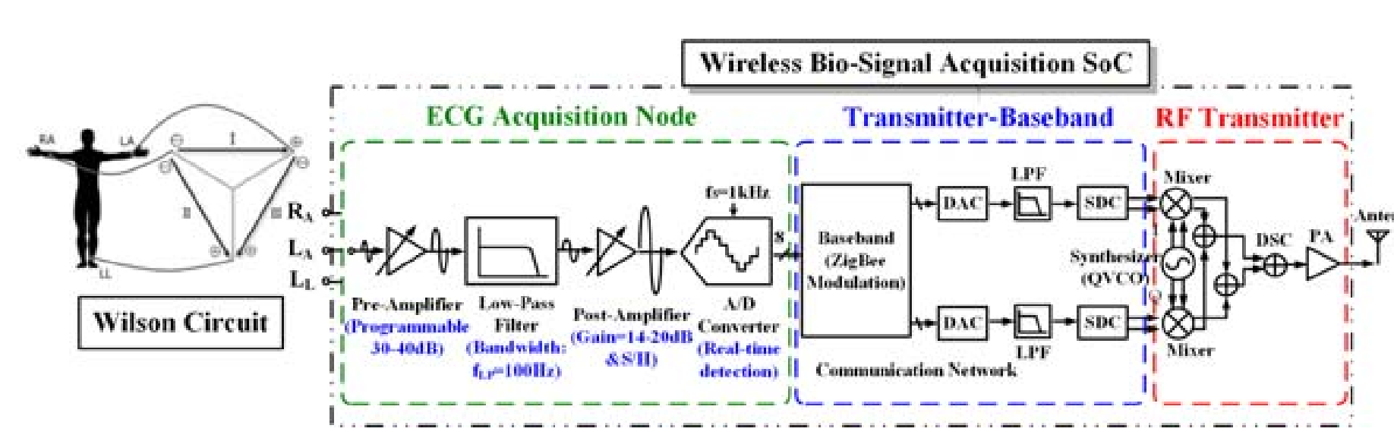
BLOCK DIAGRAM OF TRANSMITTER [7]

Slide 14
INPUT AND OUTPUT AT EACH BLOCK OF TRANSMITTER
ECG Signal - 0 to 5mV at a frequency of 50 to 150 Hz
Input Of pre Amplifier - ECG signal
Output of pre amplifier - 680mVp-p at a frequency of 50 to 150 Hz
After passing through LPF - 680mVp-p signal at a limiting frequency of 100Hz
After passing through Post amplifier - 1340mVp-p signal at a frequency of 100Hz.
Signal passed through A/D converter to transmit the signal digitally (8 bit).
After passing through Transmitter base band- A base band signal is received.
It’s an unmodulated message signal that is used for transmission.
It’s at a low frequency.
Mixer is used in the RF transmitter to modulate the input base band signal with a carrier frequency (frequency used for ISM band applications)
The signal is transmitted at a frequency of 2.4GHz with an amplitude of 1340mVp-p.

Slide 15
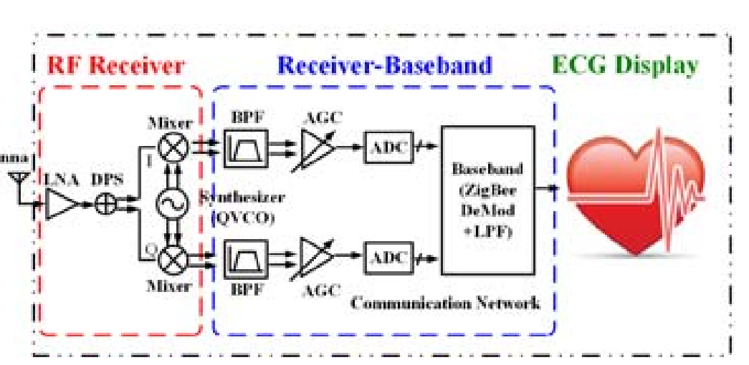
RECEIVER BLOCK DIAGRAM [7]
.

Slide 16
LNA
[5]
Low noise amplifier is a very important part of the receiver and must ensure power constrained amplification with proper impedance matching.
The designed circuit can work at supply voltage of 1V
Input
1340mVp-p signal
2.4GHz frequency
Sinusoidal wave
Output
3.6Vp-p
2.4GHz signal
Sinusoidal wave
Low noise signal
LNA

Slide 17
Target Specifications
Parameters | Target Specifications
Frequency | 2.4 GHz
Supply Voltage | 1 V
Noise Figure | <1.2 dB
Power Dissipation | <2 mW
Power Gain | >16 dB

Slide 18
DESIGN EQUATIONS:
Power Constraint:
P = V_DD* I_D
Input Impedance:
Z_IN = (g_{m} ∗L_{S}) / (C_{GS})
Quality Factor, Q = f_{o} / BW
Q = (ω( L_{G} + L_{S} ) )/(Rs)
Center frequency, f_{o} = 2.4GHz
ω_{o}² = 1/(( L_{G} + L_{S} )( C_{GS} + C_{pad} ) )
Drain Inductance in the Output Network
L_{D} = 1/(C_{OUT} ∗ω_{o}² )

Slide 19
Width can be calculated from Id equation.
I_{D}=1/2 k_{n}`(W/L)(V_{Dsat})²
Therefore,
(W/L) = (2 ∗ I_{D})/(k_{n}`∗(V_{Dsat})²
Transconductance:
G_{m} = 2 *µ_{n}*C_{ox}*I_{D}*W/L
Transition frequency, f_{T}
ω_{T} = (g_{m})/C_{GS}
Minimum Noise Figure:
NFmin ≈ 1 + 2.4 * γ/α * (ω/ω_{T} )
NFmin = 10 * log (Fmin)

Slide 20
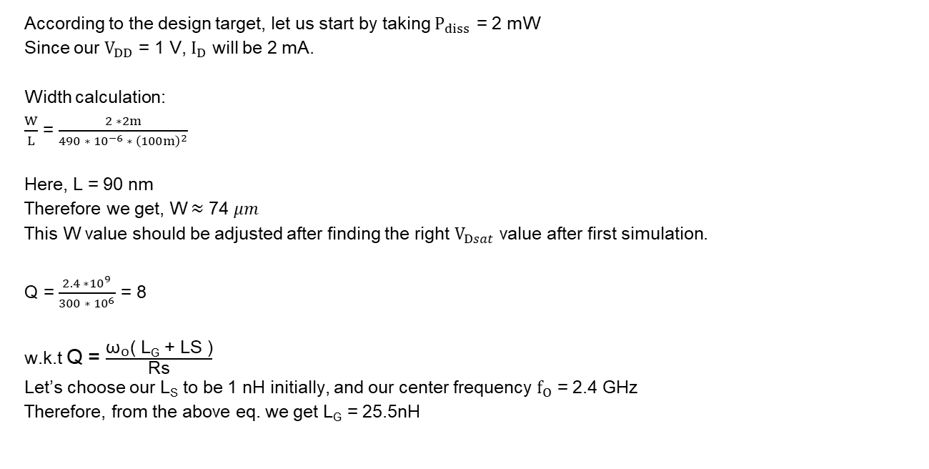
Hand Calculations
According to the design target, let us start by taking $P_{diss}$ = 2 mW
Since our $V_{DD}$ = 1 V, $I_{D}$ will be 2 mA.
Width calculation:
$\frac{W}{L}$ = $\frac{2 ∗2m}{490 ∗ {10}^{−6} ∗ {\left(100m\right)}^{2}}$
Here, L = 90 nm
Therefore we get, W $≈$ 74 $μm$
This W value should be adjusted after finding the right $V_{Dsat}$ value after first simulation.
Q = $\frac{2.4 ∗{10}^{9}}{300 ∗ {10}^{6}}$ = 8
w.k.t Q = $\frac{{\text{ω}}_{O}\text{( }\text{L}\text{G}\text{ + }\text{LS}\text{ )}}{\text{Rs}}$
Let’s choose our $\text{L}\text{S}$ to be 1 nH initially, and our center frequency ${\text{f}}_{O}$ = 2.4 GHz
Therefore, from the above eq. we get $\text{L}\text{G}$ = 25.5nH

Slide 21

Since, ω_{o}² = $\frac{1}{\text{( }\text{LG}\text{ + }\text{LS}\text{ )( }\text{CGS}\text{ + }\text{Cpad}\text{ )}}$
$\text{C}\text{GS}\text{ +} C_{PAD}$= 165.94 fF
Let us split these capacitances into $\text{C}\text{GS}$ = 106 fF and $C_{PAD}$ = 60fF
Let us calculate Ld from the o/p network:
$L_{D}$ = $\frac{1}{1 ∗ {10}^{−12} ∗ {\left(2π ∗2.4 ∗ {10}^{9}\right)}^{2}}$ = 4.39 $nH$
$g_{m}$ = $\sqrt{2 ∗490 ∗ {10}^{−6} ∗2 ∗ {10}^{−3} ∗ \frac{74 ∗ {10}^{−6}}{90 ∗ {10}^{−9}}}$ = 40.14 $mS$
${\text{ω}}_{T}$ = $\frac{40.14 ∗ {10}^{−3}}{106 ∗ {10}^{−15}}$ = 378 * ${10}^{9}$
Therefore, ${\text{f}}_{T}$ = 60 GHz
$F_{min}$ = 1 + $2.4 ∗ \left(\frac{2}{0.85}\right) ∗ \left(\frac{15 ∗ {10}^{9}}{378 ∗ {10}^{9}}\right)$ = 1.224
${NF}_{min}$ = 10log(F$min$) = 0.877dB

Slide 22
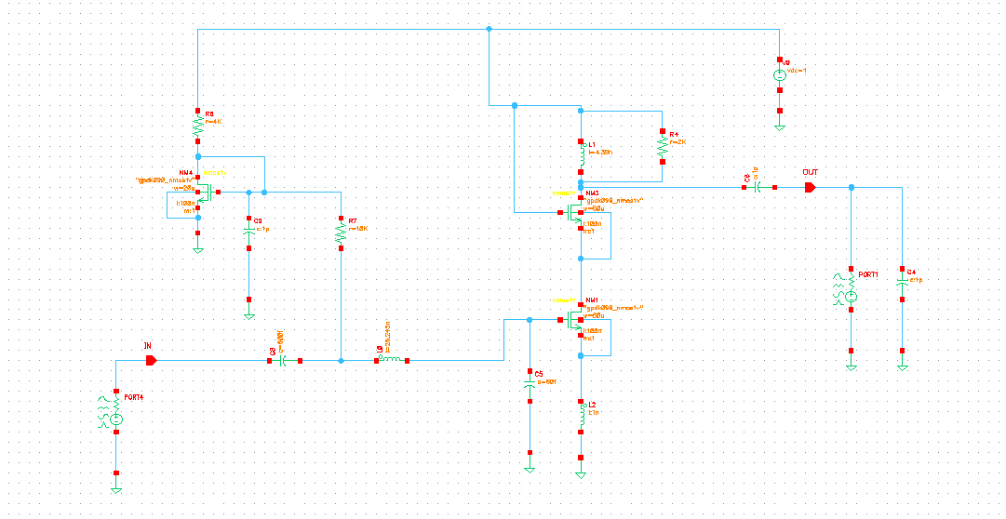
SCHEMATIC

Slide 23
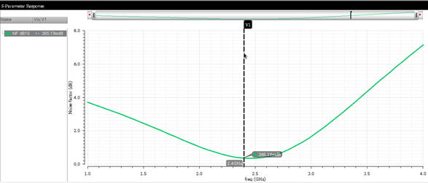
RESULTS ACHIEVED
Power Dissipation = 1.79 mW
Target specification = <2 mW
Noise Figure = 0.36 dB
Value from design calculation = 0.877 dB

Slide 24
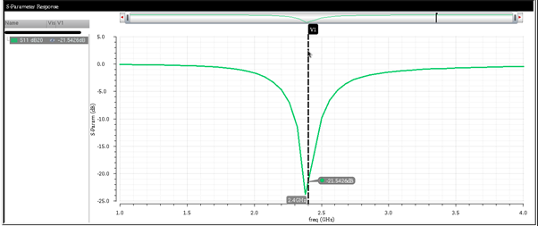
S11= -21.54dB
.

Slide 25
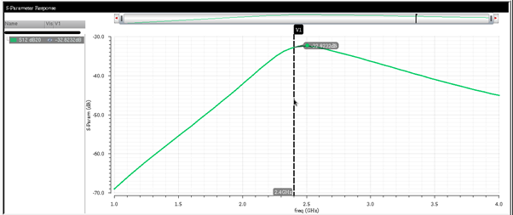
S12 = -32.82dB
.

Slide 26
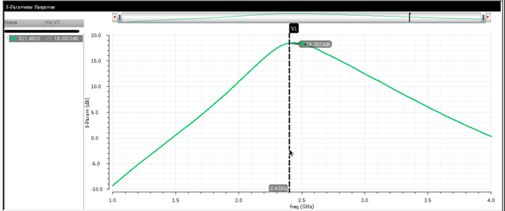
S21 = 18.38dB
,

Slide 27
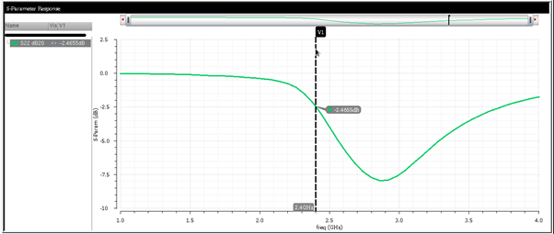
S22 = -2.46dB
,

Slide 28
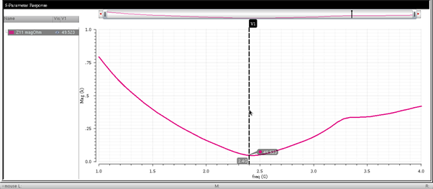
Z11 = 49.523 ohm
Target value = 50 Ohm

Slide 29
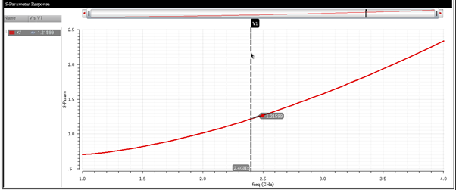

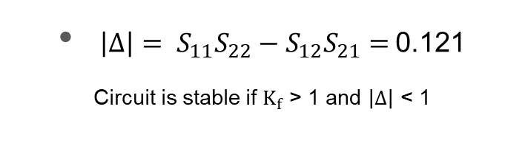
Stability ($K_{f}$) = 1.21
$\left|Δ\right|= S_{11}S_{22}−S_{12}S_{21}=$0.121
Circuit is stable if $K_{f}$ > 1 and $\left|Δ\right|$ < 1

Slide 30
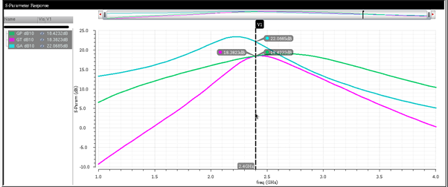
GP, GT, GA
.

Slide 31
PERFORMANCE COMPARISON WITH OTHER PAPERS
Parameters | [5] | [8] | [9] | [10] | Our Work
Frequency (GHz) | 2.4 | 2.4 | 2.4 | 2 | 2.4
Vdd (V) | 0.5 | 0.5 | 1.8 | 1.8 | 1.0
Pdc (mW) | 1.44 | 2.1 | 11.96 | 6.055 | 1.79
S11 (dB) | -27.72 |  | -5.054 | -6.61 | -21.54
NF (dB) | 1.7 | 1.5 | 2.17 | 2.049 | 0.35
Technology (nm) | 130 | 180 | 180 | 180 | 90
Gain | 16.27 | 14.13 | 18.7 | 15.2 | 18.42

Slide 32
REFERENCES:
[1] Bansal, M., & Sagar, I. (2020). Low Noise Amplifier for ECG Signals. 2020 Fourth International Conference on Inventive Systems and Control (ICISC). doi:10.1109/icisc47916.2020.9171200
[2] Muhammad Zahak Jamal. Signal Acquisition Using Surface EMG and Circuit Design Considerations for Robotic Prosthesis DOI: 10.5772/52556
[3] Bioelectric Measurements - https://web.pa.msu.edu/courses/2014spring/PHY252/Lab7.pdf
[4] Mrs.M.Bharathi*Md.Belal**, Wireless Transmission of Real Time Electrocardiogram (ECG) Signals through Radio Frequency (RF) Waves. International Journal of Scientific & Engineering Research, ISSN 2229-5518
[5] V. Reddy, P. Sammeta, R. Kumari, N. A. Quadir and A. Jain, "A 0.5 V LNA Design for 2.4 GHz Wireless Body Area Network Applications," 2019 3rd International conference on Electronics, Communication and Aerospace Technology (ICECA), Coimbatore, India, 2019, pp. 19-23, doi: 10.1109/ICECA.2019.8821857.
[6] A Project report on “REAL TIME WIRELESS ECG MONITORING SYSTEM” 2015-2016

Slide 33
[7] Liang-Hung Wang, Member, IEEE, Tsung-Yen Chen, Kuang-Hao Lin, Member, IEEE, Qiang Fang, Member, IEEE, and Shuenn-Yuh Lee, Member, IEEE. Implementation of a Wireless ECG Acquisition SoC for IEEE 802.15.4 (ZigBee) Applications
[8] R. Dai, Y. Zheng, J. He, G. Liu, W. Kong and S. Zou, “A 0.5 V Novel Complementary Current Re-Used CMOS LNA for 2.4 GHz Medical Application”, Microelectronics Journal, vol. 55, pp. 64-69, 2016.
[9] Mabusab, “DESIGN OF DIFFERENTIAL LOW NOISE AMPLIFIER FOR ISM BAND APPLICATIONS” Department Of Electronics and Communication, PESIT.
[10] Mala Narayana Swamy, “A 0.18 μm differential LNA with reduced power consumption”
[11] S. Kumaravel, A. Kukde, B. Venkataramani and R. Raja, “A High Linearity and High Gain Folded Cascode LNA for Narrowband Receiver Applications” Microelectronics Journal, vol. 54, pp. 101-108, 2016
[12] Khavari, Amir Farzad et al. “A Broadband Low Power CMOS LNA for 3.1–10.6 GHz UWB Receivers.” Journal of Iranian Association of Electrical and Electronics Engineers 14 (2018): 1-13.

